Slide 1
Self-Introduction
WANG XIN
CST-1909155

Slide 2


MY Basic Information
Chinese name: 王鑫
Male
Single w(ﾟДﾟ)w
Graduated from Guiyang No.6 High School.
Had taken part in CCTV “the Star Of Outlook”.
Have many experiences of voluntary work.

Slide 3







To Introduce Myself
Like Dogs
Love Reading
Film Editing
Notes:
Wang Xin---CST1909155

Slide 4
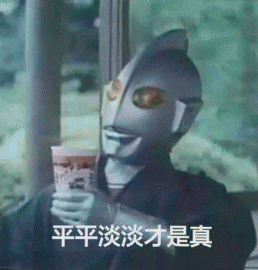
Motto
Denn man hat in der Welt nicht viel mehr, als die Wahl zwischen Einsamkeit und Gemeinheit. Arthur Schopenhauer
[人, 要么孤独, 要么庸俗] 亚瑟·叔本华
_____
Thanks
______

